Slide 1

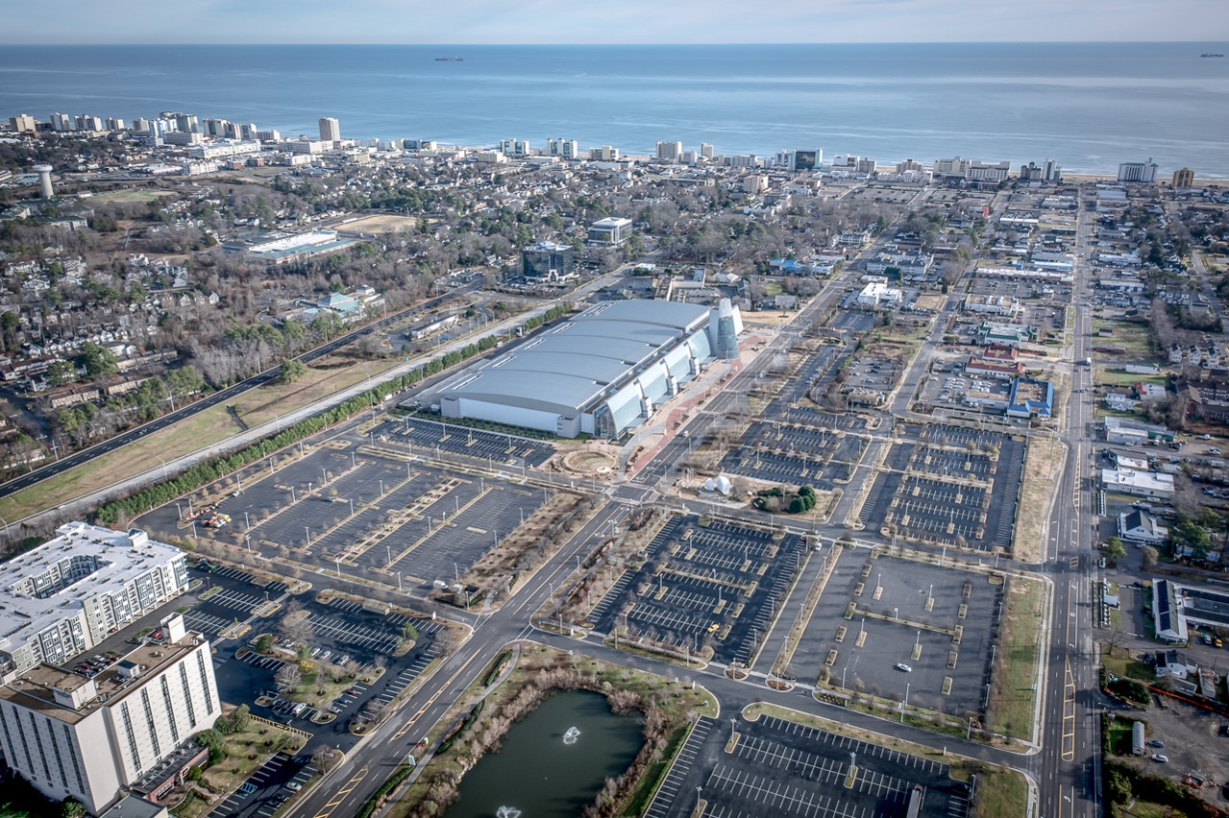
Central Beach
Entertainment District
Resort Advisory Committee Briefing
March 2018

Slide 2
Resort Strategic
Action Plan
(Adopted 2008)
Development Strategies
Create great districts with distinctive identities
Improve transit and pedestrian connections between destinations
Create a transition from the resort area to the neighborhoods
Enhance visual access to the Oceanfront
Grow residential
Provide additional higher-quality hotels
Concentrate retail
Cluster office uses near Convention Center and Birdneck
Continue to focus on achieving a "YearRound Resort"
Notes:
Resort Area Strategic Action Plan was completed in 2008 to facilitate change in development patterns for the Resort Area through a holistic approach that increased the depth of the market, brought focus to open and gathering spaces beyond the beach, and improved year round viability of the resort area.
Key focus areas on open space, connections, development opportunities and placemaking. Three primary corridors: Laskin Gateway, Marina District and the Central Beach/19th Street Corridor.
Identified development strategies included: creating GREAT districts with distinctive identities; improving connections between destinations; concentrating retail; creating transitions from resort area to neighborhoods; and achieving a “year round resort” environment.

Slide 3
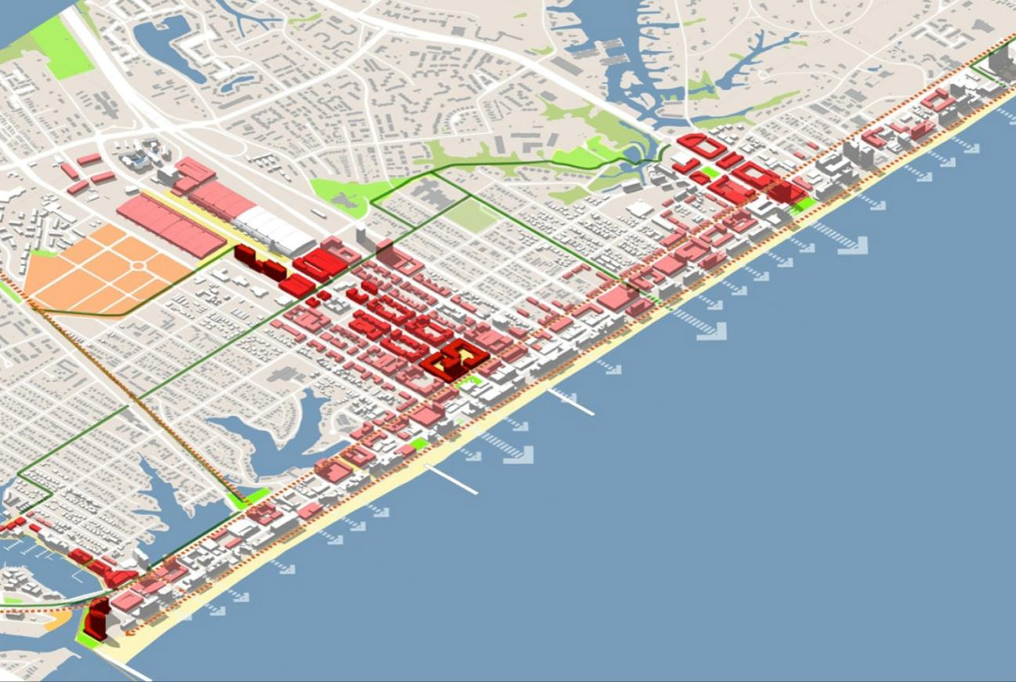
Resort Area Strategic Action Plan (Adopted 2008)
DOME
SITE
Notes:
First of 8 identified priorities: develop the Dome Site as a major entertainment venue

Slide 4
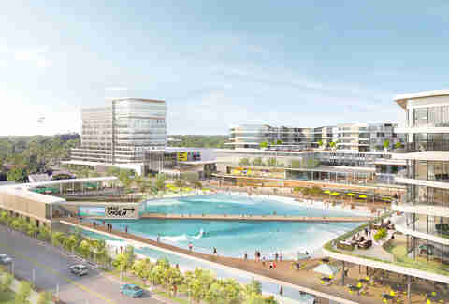

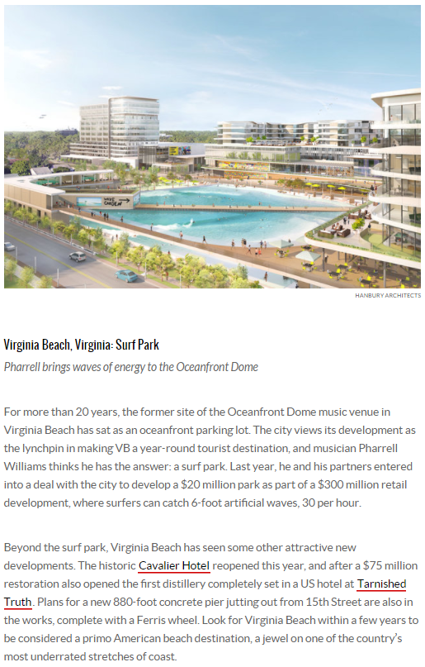
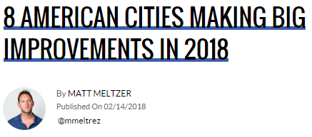
“Look for Virginia Beach within a few years to be considered a primo American beach destination, a jewel on one of the country’s most underrated stretches of coast.”

Slide 5
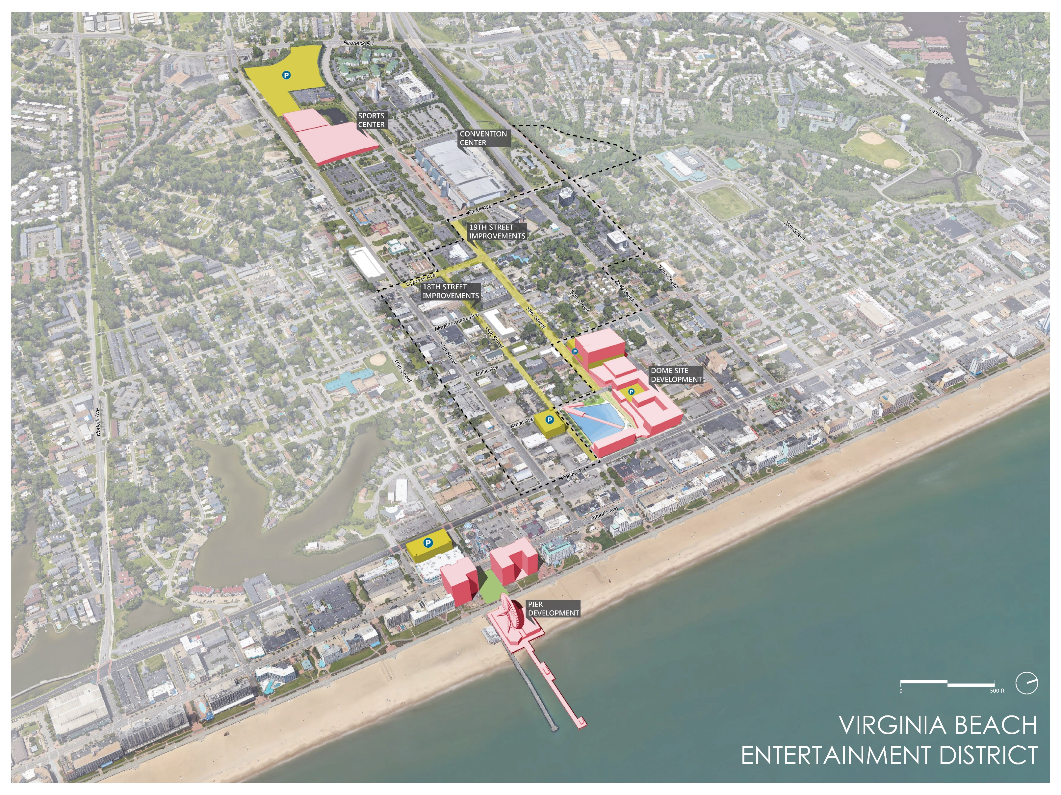

Slide 6
Convention & Sports Center
Notes:
Differentiate VA Beach from other venues (ie VB Field House)

Slide 8


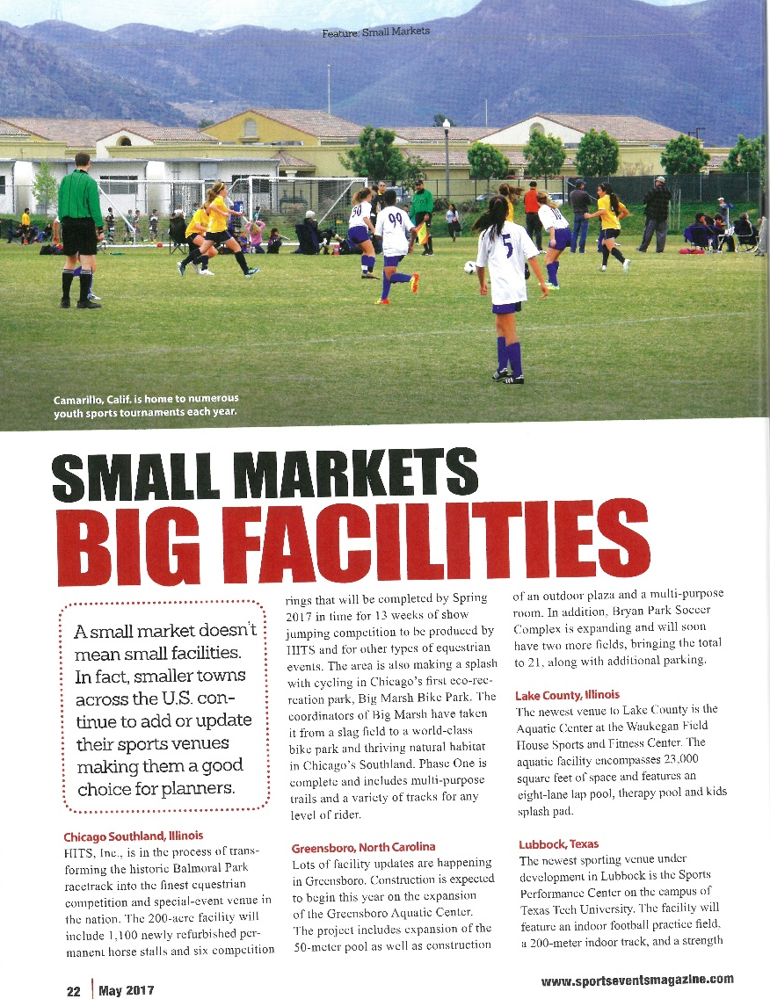
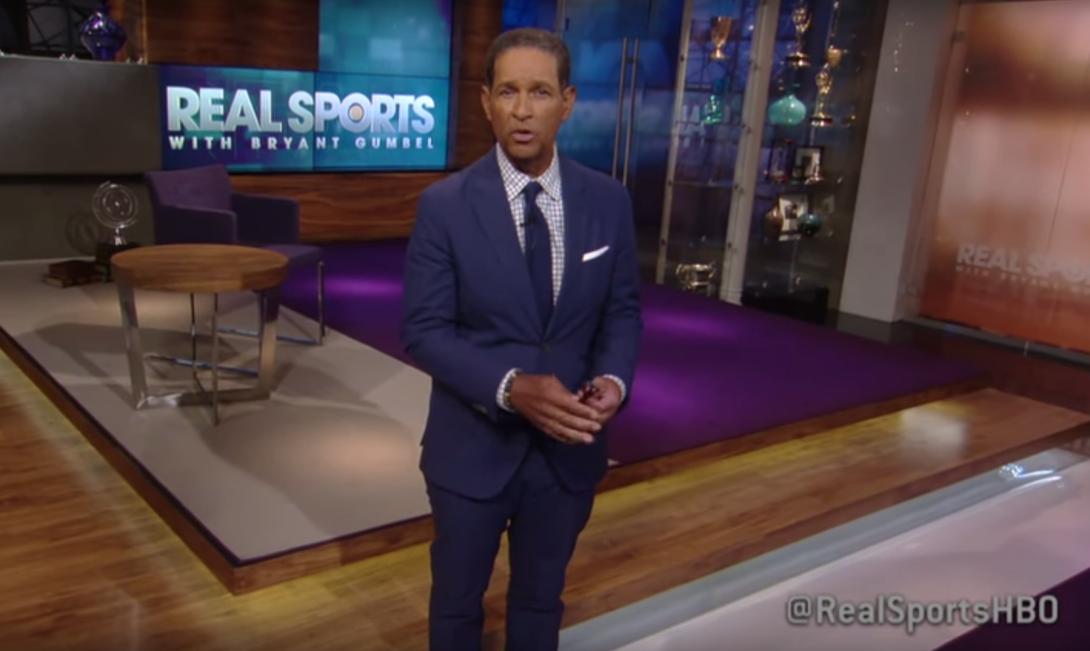
Growing Destination Competition

Slide 9

PPEA Process Overview
Solicitation of Conceptual Proposals
Decision to Proceed to Detailed Phase
Receive and Evaluate Detailed Proposals
Selection of Preferred Proposer
Comprehensive Agreement Approval by City Council
Receive, Post & Evaluate Proposals
Interim Agreement Approval By City Council
Public Hearing
Conceptual Phase
Detailed Phase
August
2017
October
2017
October
2017
November
2017
December
2017
February
2018
February
2018
July
2018
Notes:
All 3 submittals exhibited competence and experience in design and construction of similar facilities.
Typically during this phase we would short list the number of proposals moving to the detailed phase.
Because of there were no more than 3, and they were high quality conceptual submittals, we recommend moving forward to the detailed phase.

Slide 10




Selection of Design - Build and Operator Teams
Recommended Design – Builder
Recommended Operator
Notes:
ESM & Wack GC – Fredericksburg
MEB – Chesapeake; American Sports Centers – Anaheim, CA; Phase 5 – Virginia Beach
SB Ballard – Virginia Beach; SFA – SFM – Cleveland, OH

Slide 11
Summary of Material Terms
Sports Center (CIP 9-041) PPEA Interim Agreement (Design-Build)
Parties: City of Virginia Beach and MEB General Contractors, Inc.
Purpose: Advance PPEA process toward the development of a comprehensive agreement for the design and construction of the Sports Center by funding certain activities such as preliminary design and development of a guaranteed maximum price.
Term: Date of execution until November 1, 2018. However, the Interim Agreement will terminate upon one of three things: (a) execution of a comprehensive agreement; (b) either party providing notice of its intent to not proceed with the development of the project; (c) the expiration of the term

Slide 12
Summary of Material Terms
Sports Center (CIP 9-041) PPEA Interim Agreement (Design-Build)
Work Items: 15% design and engineering; surveying; preliminary site work; detailed project delivery schedule; development of offer of guaranteed maximum price.
Cost: Not to exceed $2,336,971
Developer Team: Construction Contractor: MEB General Contractors, Inc.
Architects: Clark Nexsen; Hanbury; Integrated Consulting Group
Mechanical/Electrical/Plumbing: Clark Nexsen
Structural: Clark Nexsen
Civil Engineer: Clark Nexsen
Geotechnical: GET Solutions
Hydraulic Track Consultant: Beynon Sports Surfaces
Legal: Vandeventer Black LLP

Slide 13
ViBe District

Slide 15
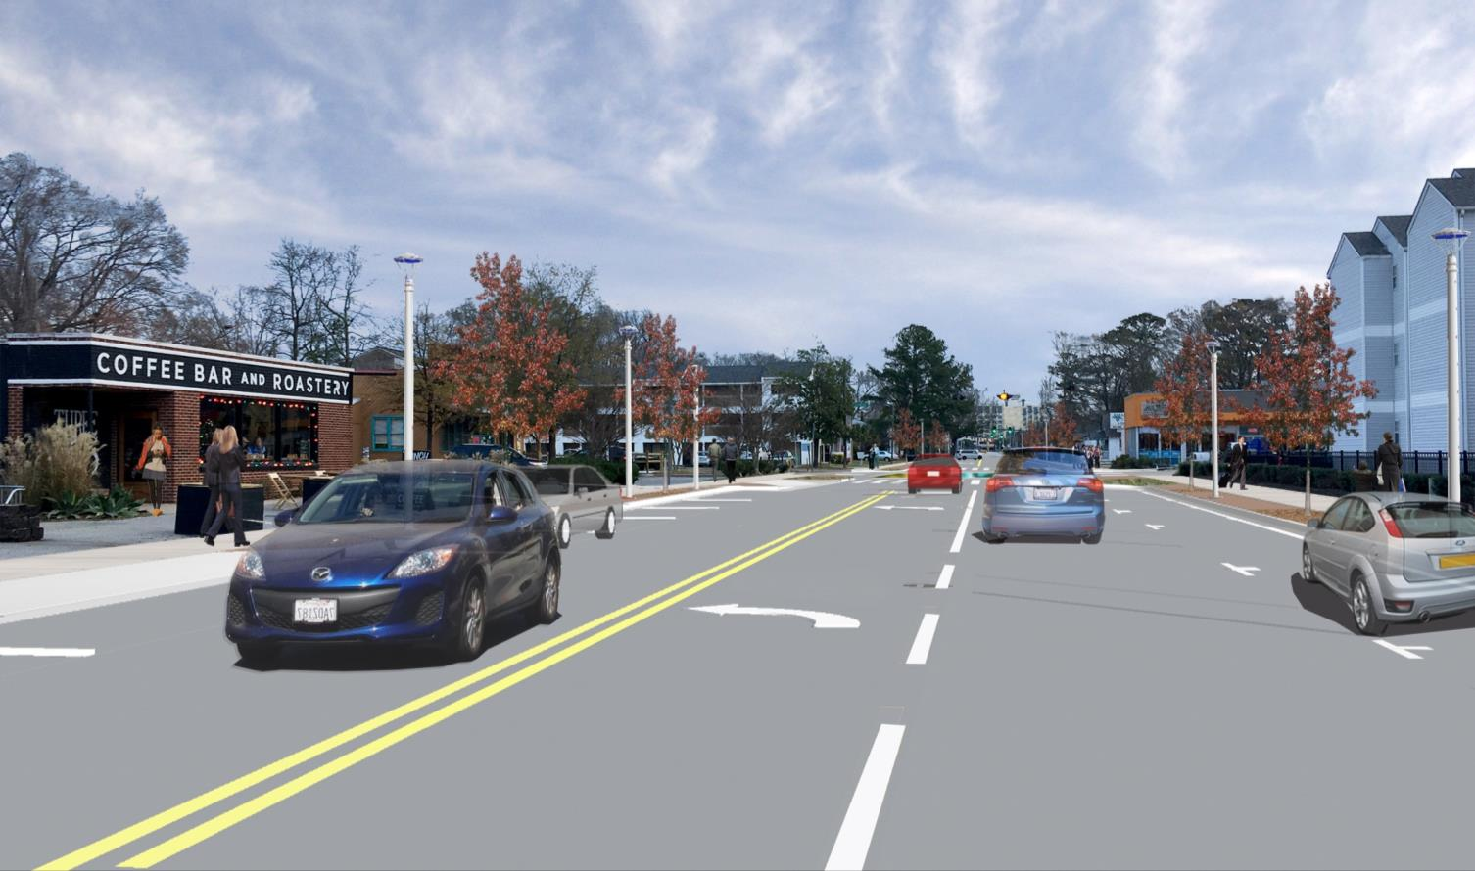
19th Street Improvements – CIP 9.100
Design complete and advertised
Construction commences – April 2018
Construction completion – May 2020

Slide 16
Dome Site

Slide 18

Dome Site Selection Process
Review and Interview
Select Qualified Developer / Operator
Public Engagement & Concept Refinement
Negotiate Public Cost Participation & Term Sheet
Approve Development Agreement
Real Estate / Financing Closing
Construction
Selection Phase
Development
Pre-Development Phase
May
2017
November
2017
January 2018
Spring
2018
Fall
2018
TBD
TBD
Notes:
Offers time to fully vet concepts and feasibility with an option for public engagement
Establishes timelines and schedules
Allows for financing due diligence

Slide 19
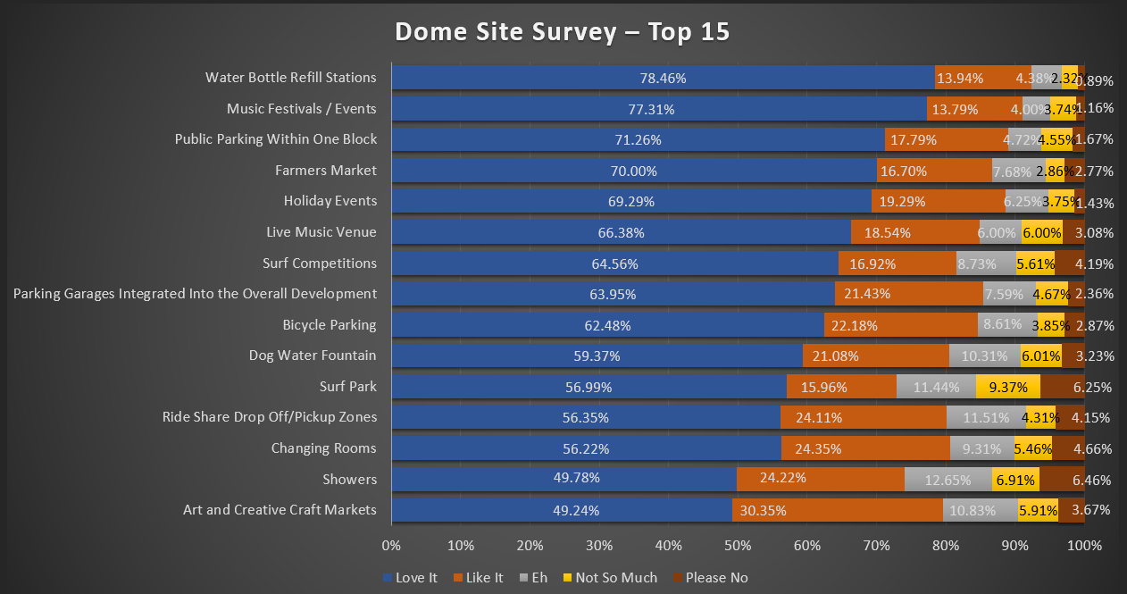
Highlights of Survey Responses (Over 2500)

Slide 20
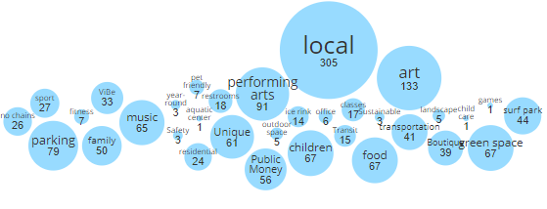
Highlights of Survey Written Responses (Over 1400)
Five open-ended questions offered respondents the opportunity to provide additional comments. The survey also enabled participants to provide “upvoting” or support for other participants’ comments. Here is a graphic “wordle” or word cloud of the themes identified in comments across all five questions:

Slide 21
Next Steps – March - May
Exclusive Dealing Period Feasibility Studies
Entertainment Feasibility Study
  Validate market demand and affirm recommendations for size of venue
Retail Feasibility Study
  Validate market demand and affirm recommendations for retail mix
Overall Economic Impact Analysis
  Forecast overall economic impact of entire mixed use development
Parking Feasibility Study
  Validate parking demand and recommend total # of spaces
Construction Cost Verification
  Verify estimated construction costs and provide market comparisons

Slide 22
Pier Development

Slide 24
Pier Process Overview
City Receives Unsolicited Proposal for Pier Replacement and Mixed Use Development
- Proposal Not Accepted
City Receives Unsolicited Proposal for Pier Replacement and Mixed Use Development
- Proposal Not Accepted
Unsolicited Proposal & Term Sheet Reconsidered - Council Briefing & Liaisons Appointed
Unsolicited Proposal & Term Sheet Reconsidered – Direction to Negotiate Terms
Pier Development Term Sheet Ordinance to City Council
City Grants Last Multi-year Pier Franchise Agreement
March 15th Entertainment District Public Engagement Workshop includes Pier
Pier Term Sheet and VBDA Lease Briefed to City Council and VBDA
October
2014
November
2014
January
2015
January
2016
December
2017
February
2018
March
2018
April
2018
Notes:
All 3 submittals exhibited competence and experience in design and construction of similar facilities.
Typically during this phase we would short list the number of proposals moving to the detailed phase.
Because of there were no more than 3, and they were high quality conceptual submittals, we recommend moving forward to the detailed phase.

Slide 25
Proposed Pier Project Terms
$21.5 M for a minimum 880 foot public pier
  Include demolition of existing pier, lighting and utilities
  Include fishing for fee component
$3.5 M for 175 public parking spaces
Require 60 foot wide public park connecting public Boardwalk to Atlantic Avenue
Require a minimum of $40 M of private investment in “top side” improvements
VBDA to sublease to private operator for 40 year term
  Operator responsible for routine operational maintenance
  City / VBDA responsible for capital maintenance
  City / VBDA to own pier and top side improvement at end of 40 year term

Slide 26
Potential Public Private Development
Approximately $200 M private sector investment to include:
  200 foot high sky entertainment wheel and associated amenities
  Not to exceed 60,000 square feet of commercial, entertainment, retail, and/or restaurant space that includes:
    Replacement of Ocean Eddie’s and one additional restaurant
    Public restrooms
    Surfing museum or hall of fame
    Tackle Shop
    Souvenir Shop
    Complimentary Retail
  2 hotel towers (one to be upper upscale hotel and one may be timeshare)
Participation in the Tourism Development Financing Program (TDFP)

Slide 27
Central Beach Parking

Slide 29
Resort Area Parking Strategy Districts
Building on the Resort Strategic Action Plan, the 2013 Resort Area Parking Strategy identified seven parking districts in the Resort Area and the Convention Area.
Each parking district was identified by considering the parking challenges unique to each district.

Slide 30
Park + Baseline Scenario

Slide 31
Walk Distances – Highlighted Projects

Slide 32
Park + No Build Scenario – New Uses

Slide 34
CIP Funding to Support the Projects

Slide 35
Central Beach Entertainment District Proposed Capital Funding
Project | Amount
Central Beach and Convention Parking | $60,000,000
Sports Center | $50,000,000
Dome Site Entertainment Venue | $30,000,000
Dome Site Streetscapes | $7,500,000
Pier Replacement | $21,500,000
ViBe District (18th & 19th Streets) | $23,800,000
Total | $192,800,000

Slide 36
Potential Leveraged Private Investment
Project | Public | Private
Central Beach and Convention Parking | $60 M
Sports Center | $50 M | $2M
Dome Site Entertainment Venue | $30 M
Dome Site Streetscapes | $7.5 M
Dome Site Development (The Wave) |  | $150 M - $200 M
Pier Replacement | $21.5 M
Pier Place Development |  | $154 M - $228 M
ViBe District (18th & 19th Streets) | $23.8 M
Total | $192.8 M | $306 M - $430 M

Slide 37
Questions /
Discussion

Slide 38
Appendix

Slide 40
Lease solicitation responses
Virginia Beach Development Authority
  In order to achieve a public private partnership through a Development Agreement and Sublease Agreement
Wool Services Supply & Logistics, LLC
  Additional written response received on February 19th

Slide 41
Request for additional information from WSSL, LLC
Elements of the pier – including length, width, materials to be used, amenities to be included (e.g. restaurants, retail, etc.)
Anticipated cost of the improvements
Source of funds for the improvements, including public participation
Previous development projects completed by WSSL, LLC and evidence of capacity to complete a pier development
Identification of development partners, including architect, contractor, engineer
Identification of associated development to be completed with the pier

Slide 42
Response to request for additional information from WSSL, LLC
Response provided no details
No anticipated cost of improvements
Response provided no details of private funding, but referenced use of the City’s TIP Fund
Response provided no details
Response provided no details
Response provided no details

